Slide 1
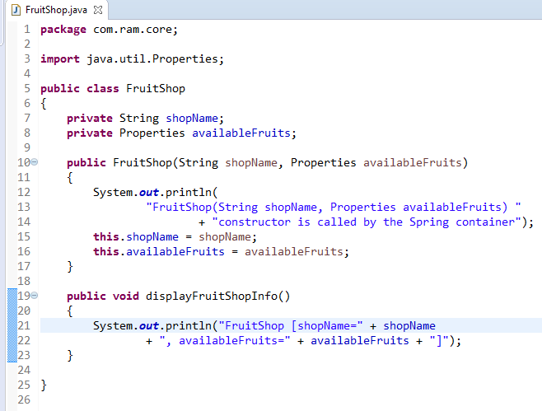
Constructor Injection with Properties

Slide 2
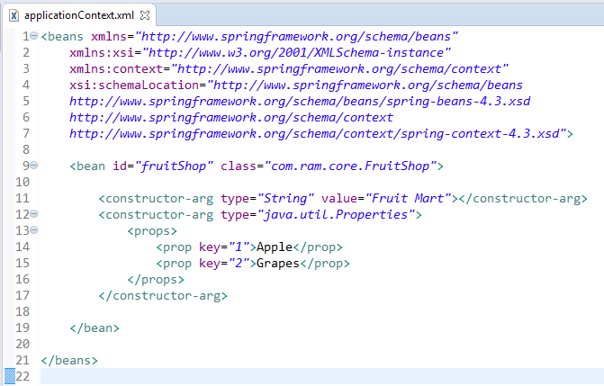
Constructor Injection with Properties
We are providing the information into the bean by applicationContext.xml file.
The constructor-arg element invokes the constructor.The type attributes specifies that String, Properties parameter constructor will be invoked. In this example FruitShop(String shopName, Properties availableFruits) constructor will be invoked.
The props element of constructor-arg is used here to define the Properties.
The prop attribute of props is used to define the key and value information.

Slide 3
Constructor Injection with Properties
FruitShop
What object to instantiate?
What object to configure and how to configure?
The Spring Container
(ApplicationContext)
applicationContext.xml
FruitShop
Object
FruitShop [shopName=Fruit Mart,
availableFruits={2=Grapes, 1=Apple}]
Create the FruitShop object.
Configure the FruitShop object.
Manage FruitShop object complete life cycle from creation till destruction.

Slide 4
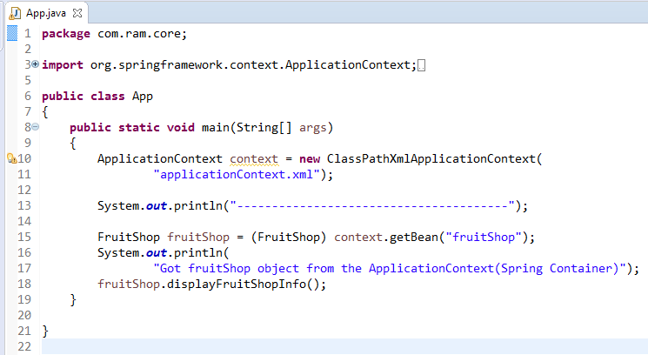
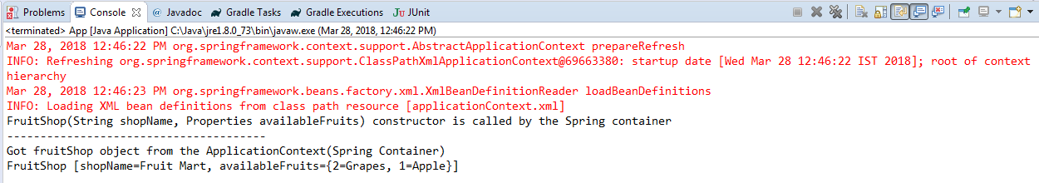
Constructor Injection with Properties

